Slide 1
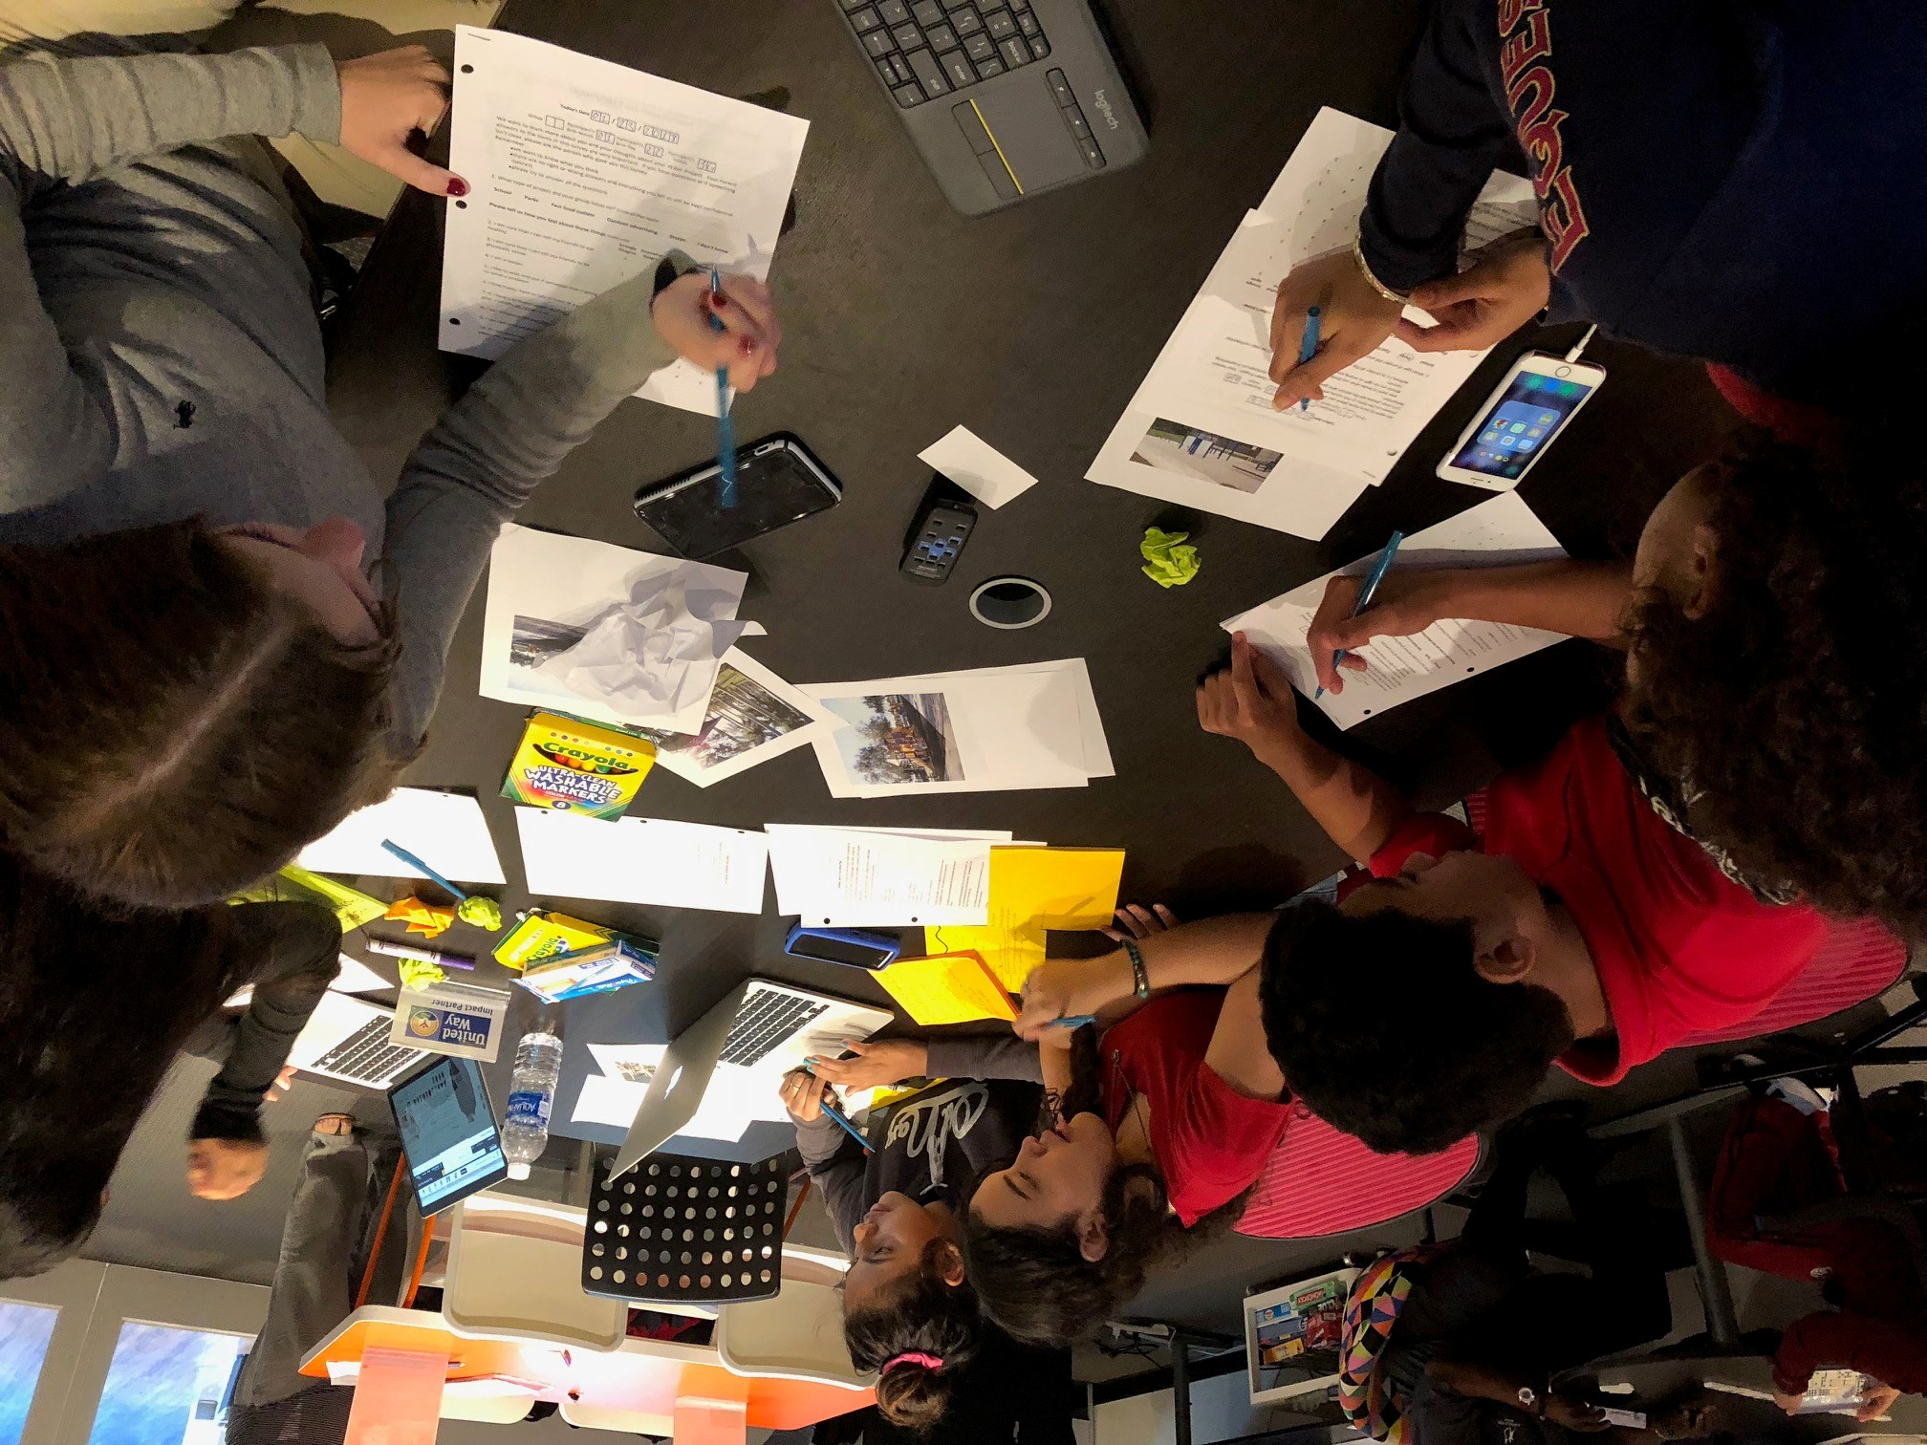
Session 7
Conduct YEAH! Project Research

Slide 2
7|Conduct YEAH! Data Research
Session Overview
In this session, YEAH! club members will conduct surveys and interviews with community members and research other community data.
Community assessments can demonstrate challenges but when it comes time for the final presentation, it is helpful to have supporting evidence. Doing data research from sources like the census can help, but public data may not be enough. Surveys and interviews of community members or peers can provide quantitative (information represented by numbers) and qualitative data (information that helps tell a story). Youth participants can include the findings in their final presentation.
Session Prep and Reflection:
What’s your plan for this session?
What worked well?
What did not work well?
What was a challenge for you?
What were the “wows” from this Session?
What are you going to do differently next time?

Slide 3
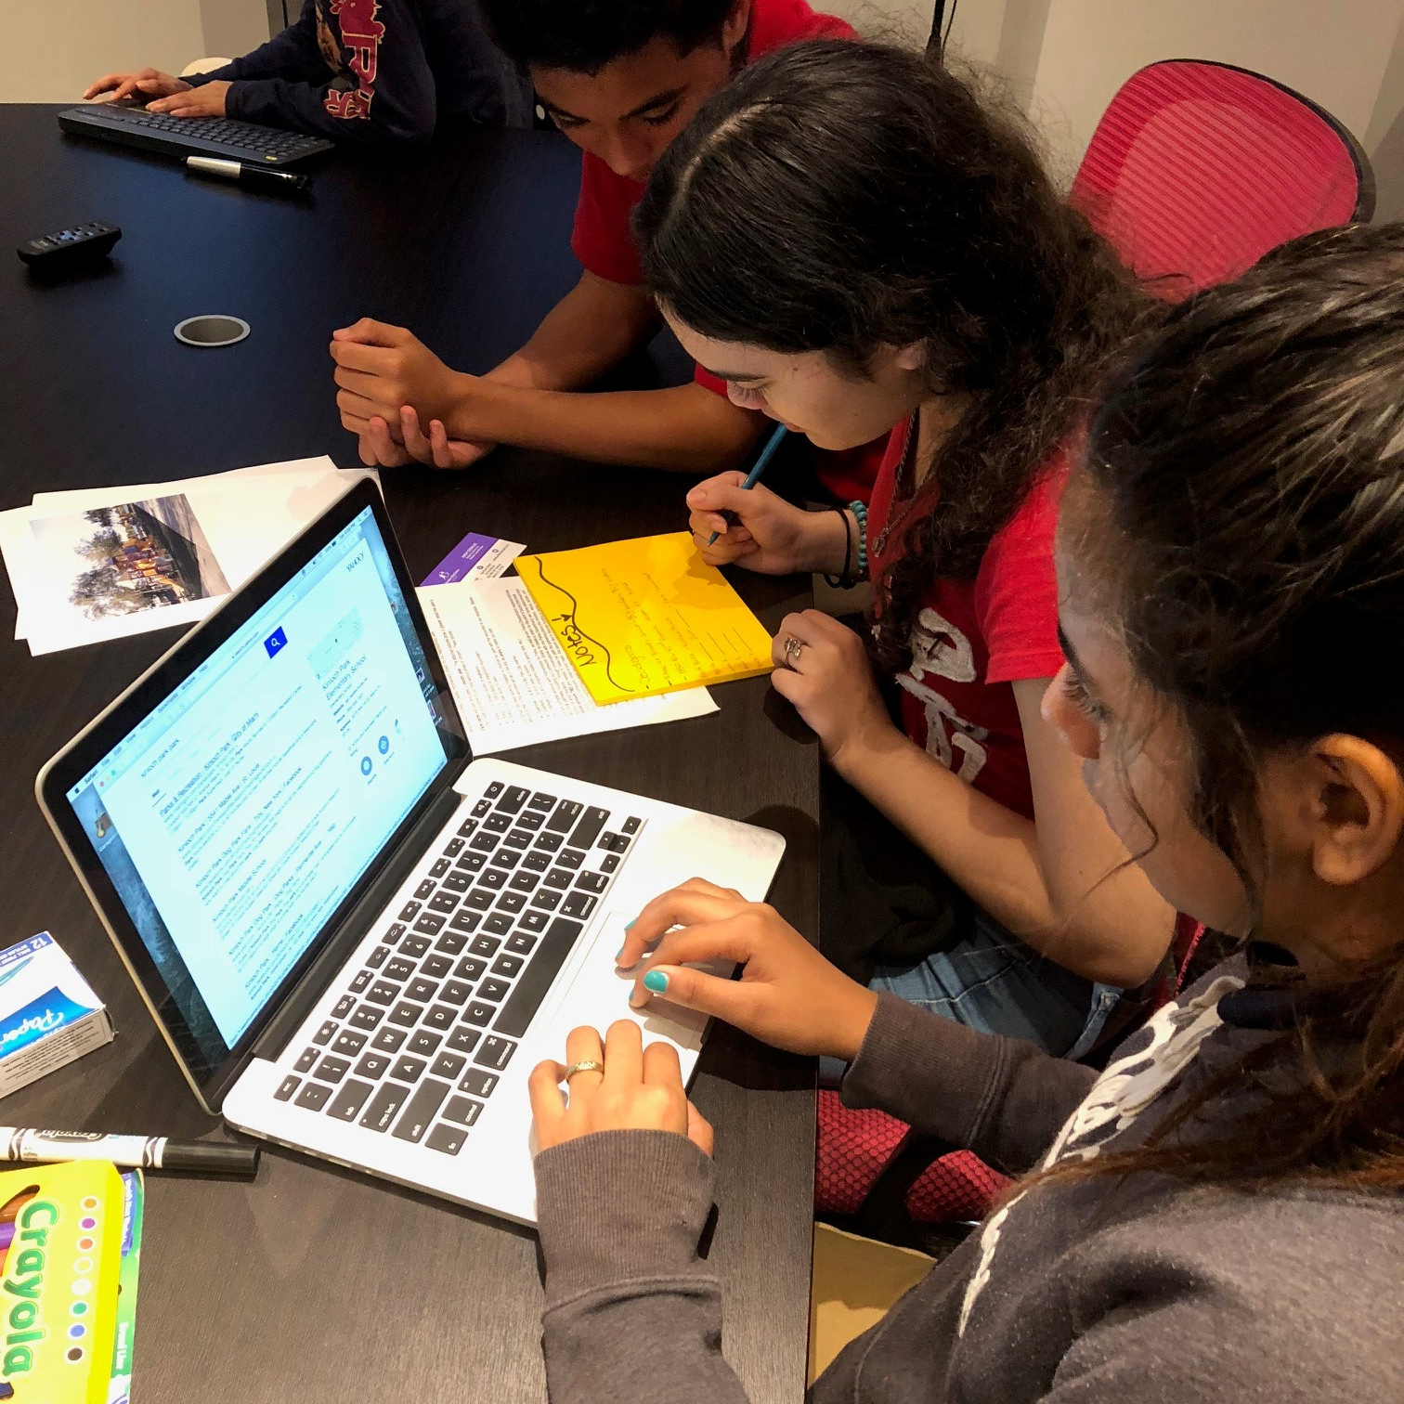
7|Conduct YEAH! Data Research
Purpose of Activity:
To find supporting data for the final presentation
Instructions
Have the youth work through online resource Data Worksheet
data research
questions for discussion
Does the data surprise you?
Does the data alone tell the whole story?
What data do you want to include in the final presentation?
Time
Materials
30-45 Minutes
Paper, Pen and Computers with Internet Access

Slide 4
7|Conduct YEAH! Data Research
Purpose of Activity:
To have youth participants survey community members or peers to get supporting data for their final presentation
Instructions
Have the youth prepare survey questions and conduct surveys; examples are available in the online resource Sample Surveys
questions for discussion
What information is missing from the assessment and what questions would fill that hole?
Who should be interviewed?
How many people should be interviewed?
Community survey
Time
Materials
1 Hour
Pen and Paper

Slide 5
7|Conduct YEAH! Data Research
Purpose of Activity:
To collect relevant stories and quotes from community members or peers for final presentation
Instructions
Have the youth prepare survey questions and conduct interviews; examples are available in the online resources Sample Interviews
questions for discussion
What information is missing from the assessment and what questions would fill that hole?
Who should be interviewed?
How many people should be interviewed?
Community Interviews
Time
Materials
1 Hour
Pen, Paper and Voice Recorder (if available)

